Slide 1
Trust and Transparency in Learning Analytics
LAK18 Hackathon
Tim Cavanagh
George-Petru Ciordas-Hertel
Tore Hoel
Damian Sweeney

Slide 2
Guiding principles
Transparency
Communication
Rights & Responsibilities
Governance
Education is our business!

Slide 3
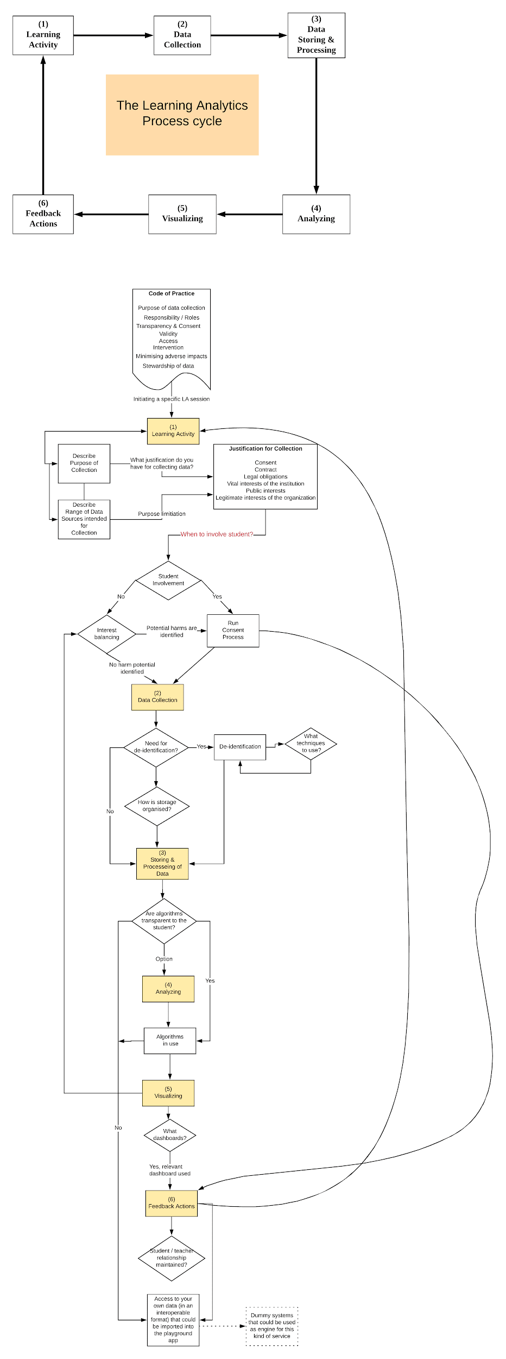
Learning Analytics Privacy Process
(there will be a test on this at the end)

Slide 4
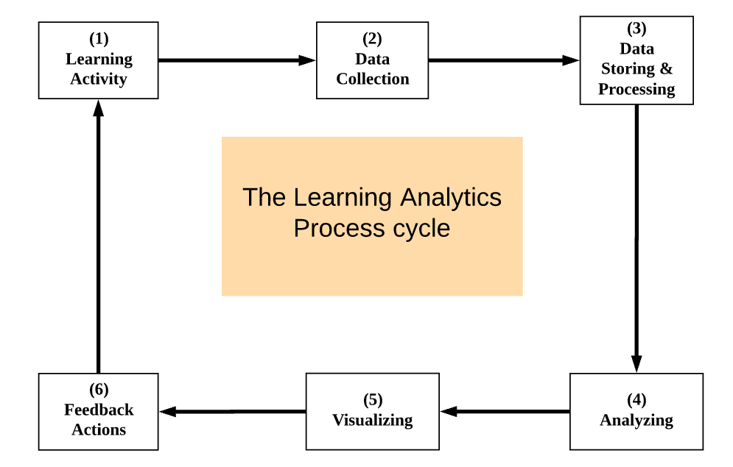

Slide 5
Preparation
Establish a Code of Practice
Purpose of using LA
Responsibility
Transparency and Consent
Confidentiality
Validity
Access
Intervention
Minimising adverse impacts
Stewardship of data
Setting up teams

Slide 6
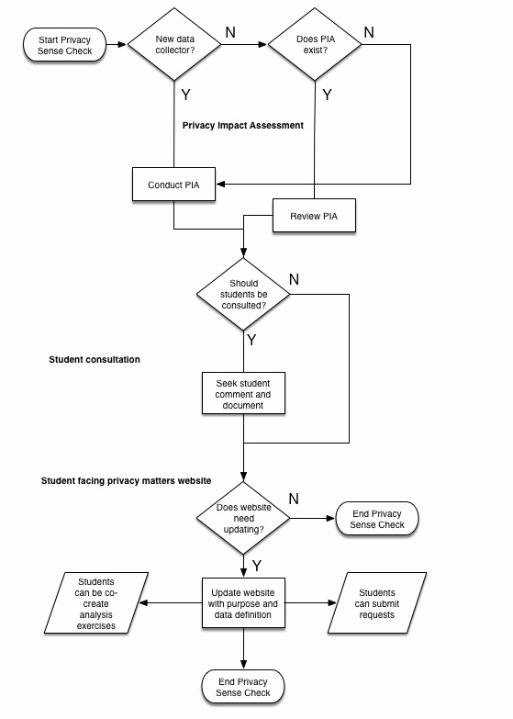
Privacy Sense Check
Follow principles of Transparency First, Privacy by Design and Stakeholder Engagement
Capture auditable activity
Standardised approach
Involve stakeholders (consult and/or participate)
Share information
Capture feedback

Slide 7
Learning Activity
Students ask:
Do you know what you’re doing in this learning activity?
Have you done it before?
What data are you using and why?
What decisions will you make with my data (assessment, feedback, etc.)?
Service Designers consider:
Learning design
Tools to be used
Data to be collected
How data will be used?
Do data measure what you think?

Slide 8
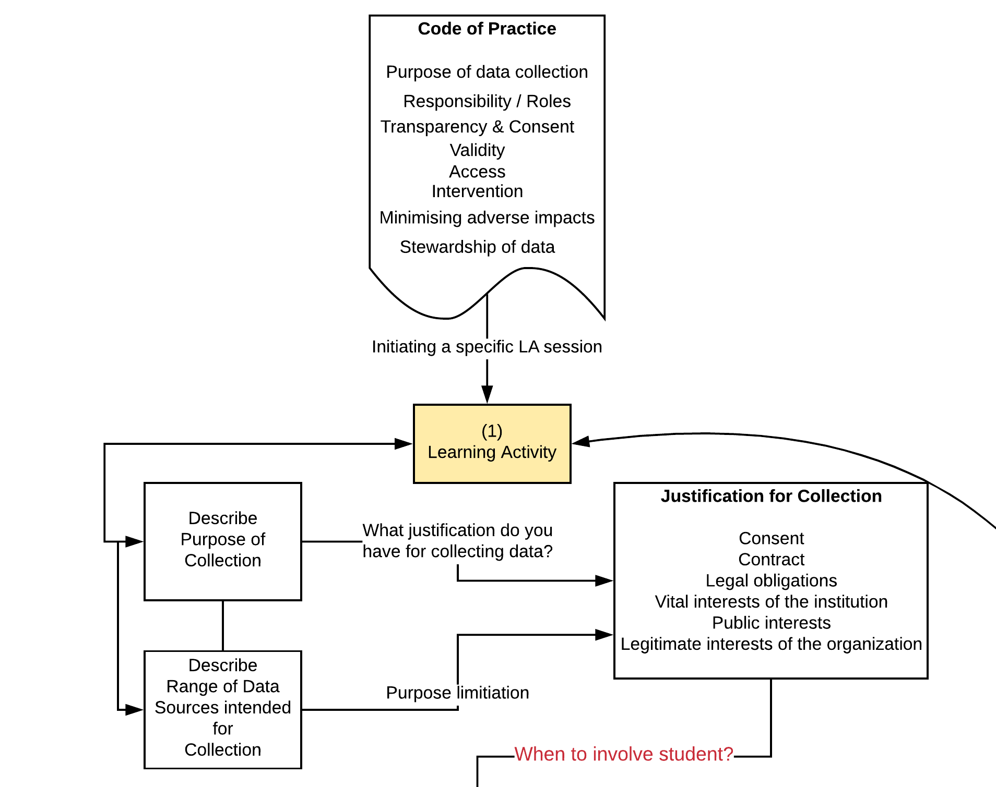

Slide 9
Data Collection
Students ask:
Where is the data coming from?
How are you collecting the data?
Will it be used for any other purpose?
Who will have access to it (is it just for this activity/ class/ module/ institution)?
Can I opt out?
Service Designers consider:
When do we have to involve the students (balancing of interests)?
Is de-identification required?
Privacy Impact Assessment completed?
What storage solution will be used – and how do I relay that to the students

Slide 10
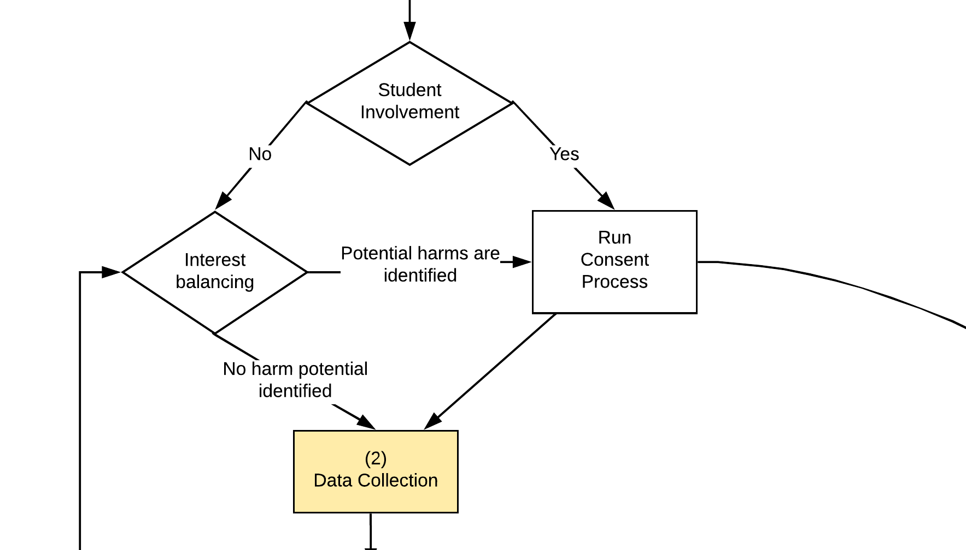
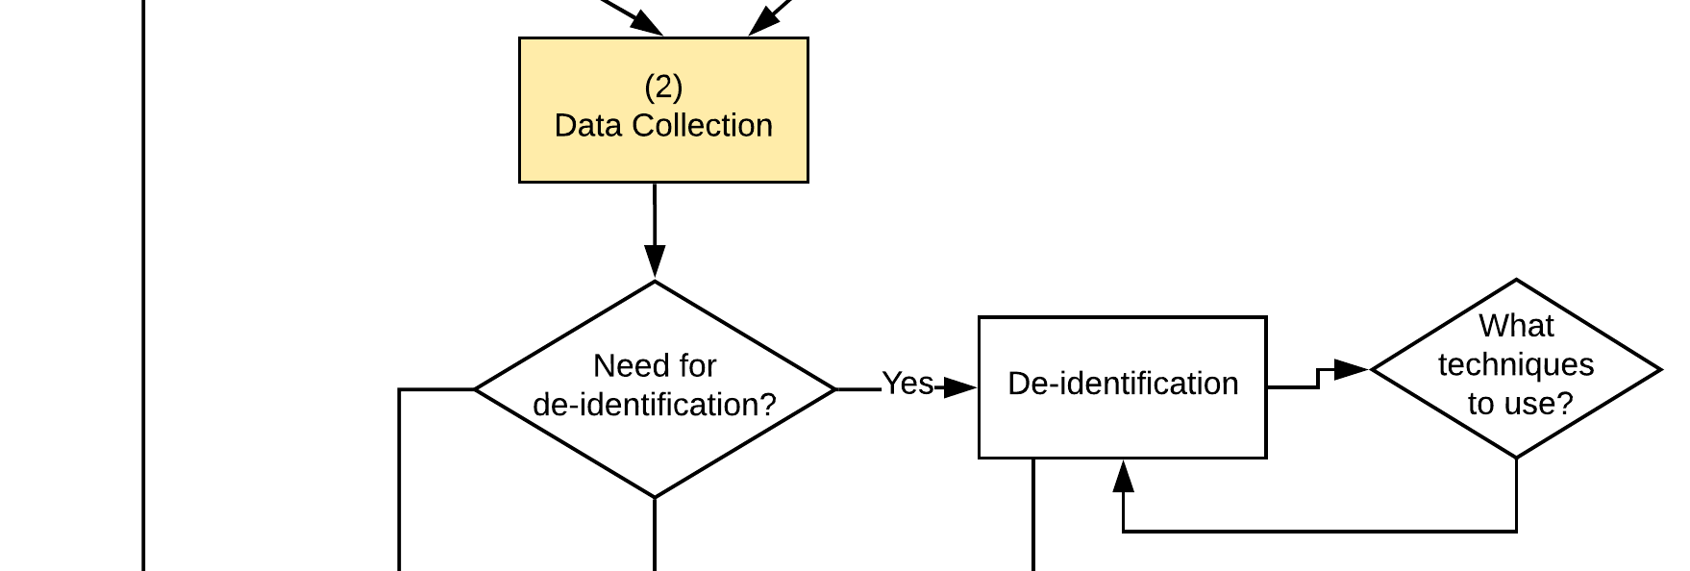

Slide 11
Storage and Processing of Data
Students ask:
Are my data safe?
Who are handling my data?
How long will my data be stored in the system?
What kinds of information are you keeping as part of this process?
Is there anonymisation being used?
Can my data be re-identified?
Service Designers consider:
How to do pseudonymisation?
Locally stored, in the Cloud, stored by 3rd party?
Students have a right to get all their data ➔ Privacy by Design!

Slide 12
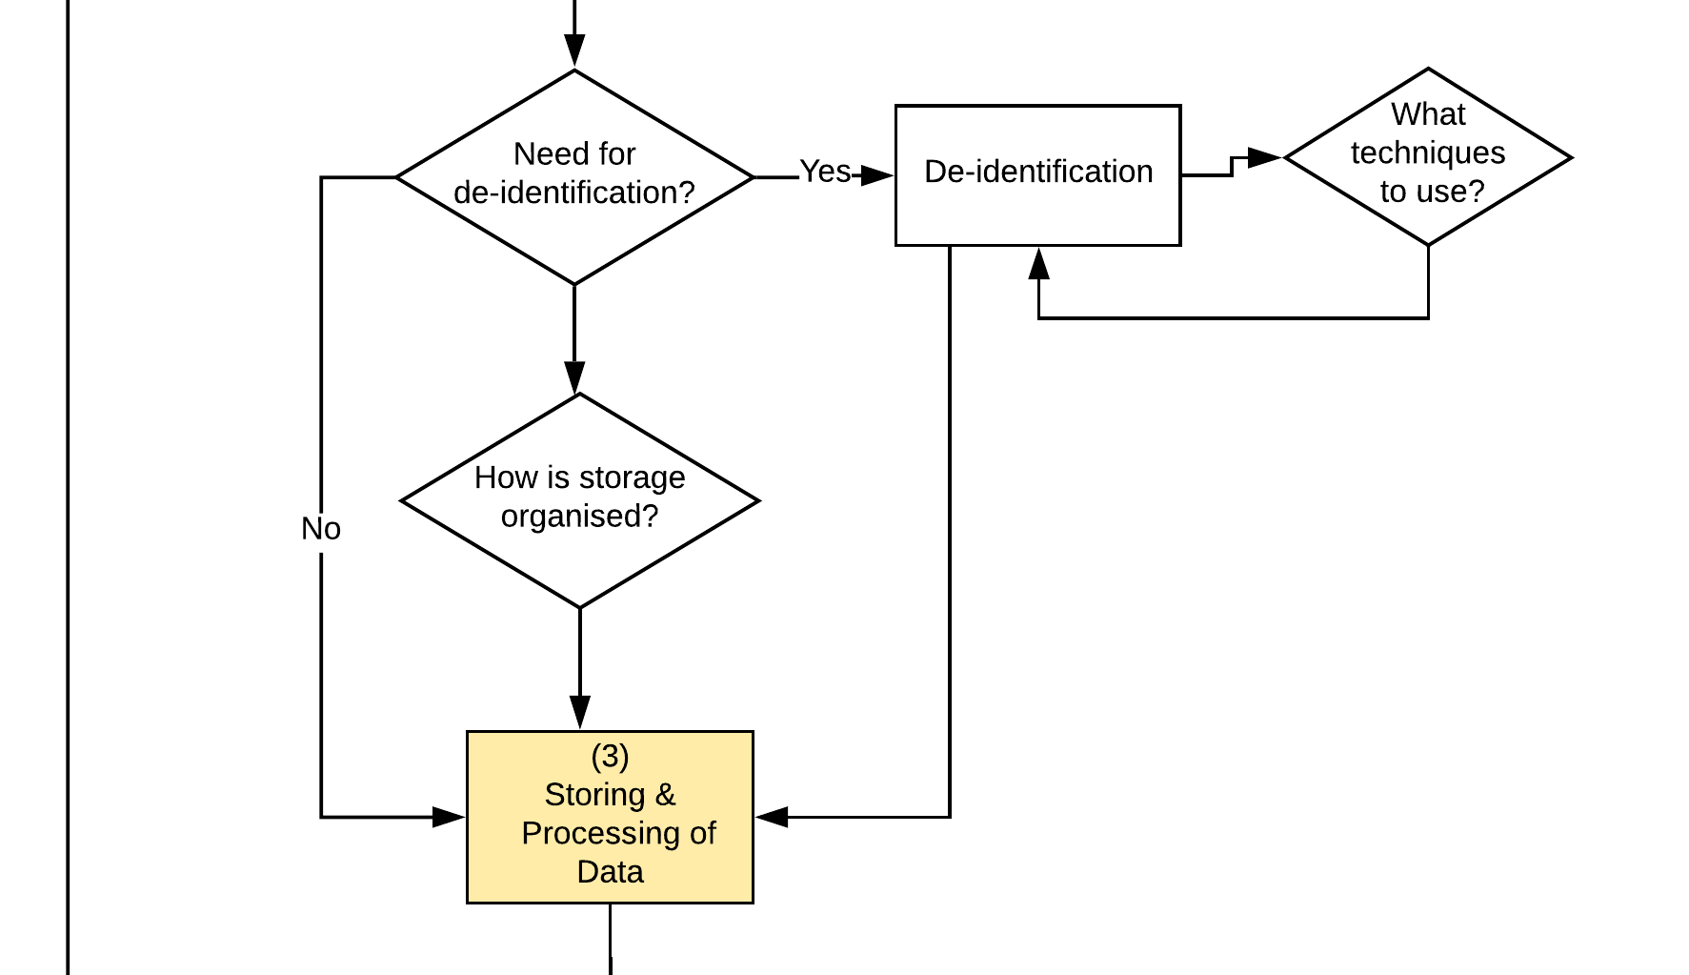

Slide 13
Analysis
Students ask:
How is the analysis conducted?
Is the analysis valid?
What decisions will flow from the analysis?
Is the decision automated or is a human involved?
When is the analysis happening (real-time or after the fact)?
Service Designers consider:
What algorithms are in use?
Can I describe them for a lay audience?
What tools will help me explain?
Can any risks be identified in the analysis?
How will this be communicated to students?

Slide 14
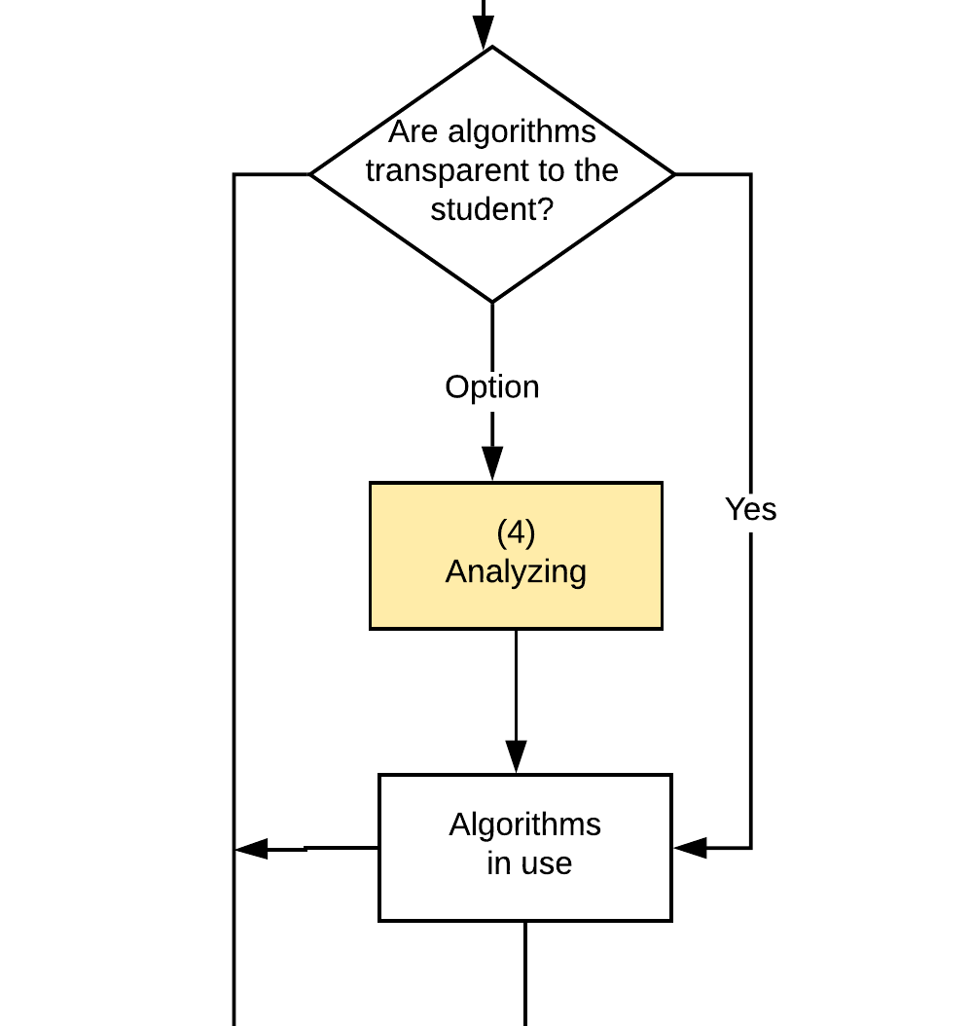

Slide 15
Visualisation
Students ask:
Does the visualisation obscure the underlying data in any way?
Are there opportunities for misinterpretation?
Who can see my dashboard?
Service Designers consider:
Is the presentation model valid for the analysis being visualised?
Do the consumers of the visualisation (staff or students) know how to interpret it?
Different dashboards for different target groups?

Slide 16
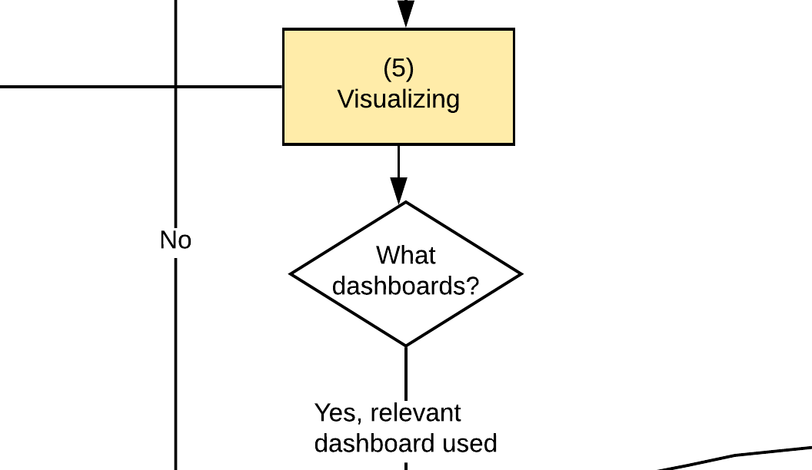

Slide 17
Feedback Actions
Students ask:
How is the action and the data involved in the decision communicated to me?
Can I appeal a decision based on this analysis?
Is this relevant to my learning or just noise?
Service Designers consider:
Who initiates the action, based on what criteria?
How will this inform the learning design of the next activity?
Will this be communicated to students?
Is there an appeal mechanism in place?

Slide 18
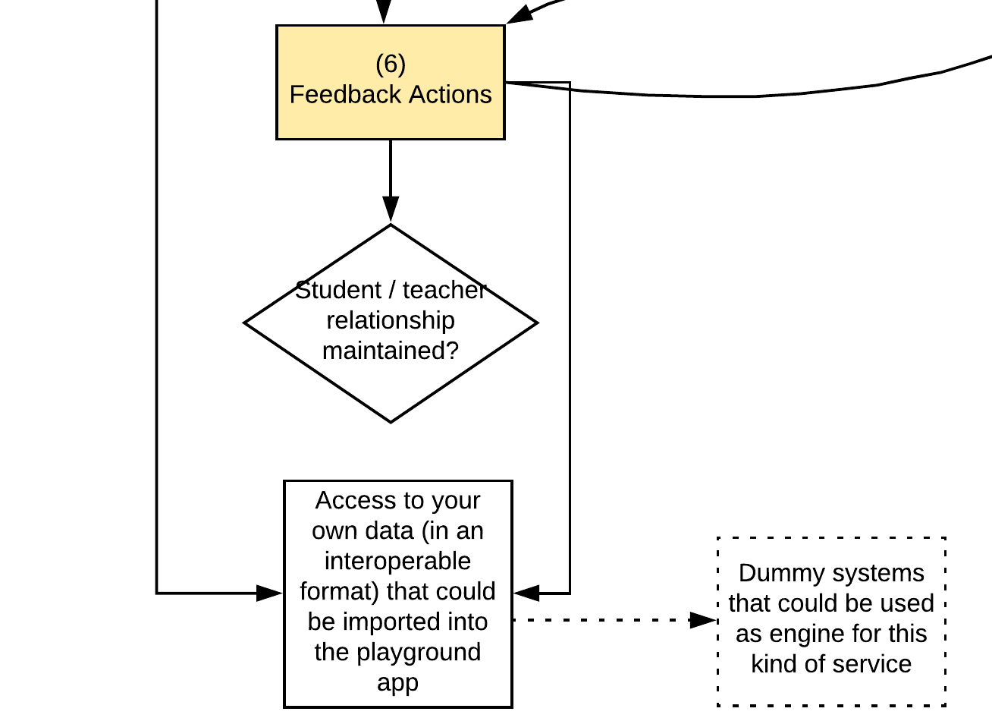

Slide 19
After thoughts
Do we have a governance process in place?
Is there a paper trail?
Will more datasets be included in the next round?
Should we do something else…. Go for a walk, perhaps….

